Slide 1
Accounting Principles, 7th Edition
Weygandt • Kieso • Kimmel
Chapter 1
Accounting in Action
Prepared by Naomi Karolinski
Monroe Community College
and
Marianne Bradford
Bryant College
John Wiley & Sons, Inc. © 2005

Slide 2
CHAPTER 1
ACCOUNTING IN ACTION
After studying this chapter, you should be able to:
1 Explain what accounting is.
2 Identify users and uses of accounting.
3 Understand why ethics is a fundamental business concept.
4 Explain the meaning of generally accepted accounting principles and the cost principle.

Slide 3
CHAPTER 1 ACCOUNTING IN ACTION
After studying this chapter, you should be able to:
5 Explain the meaning of the monetary unit assumption and the economic entity assumption.
6 State the basic accounting equation and explain the meaning of assets, liabilities, and owner’s equity.
7 Analyze the effect of business transactions on the basic accounting equation.
8 Understand what the four financial statements are and how they are prepared.

Slide 4
WHAT IS ACCOUNTING?
STUDY OBJECTIVE 1
Accounting is an information system that
Identifies
Records
Communicates the economic events of an organization to interested users

Slide 5
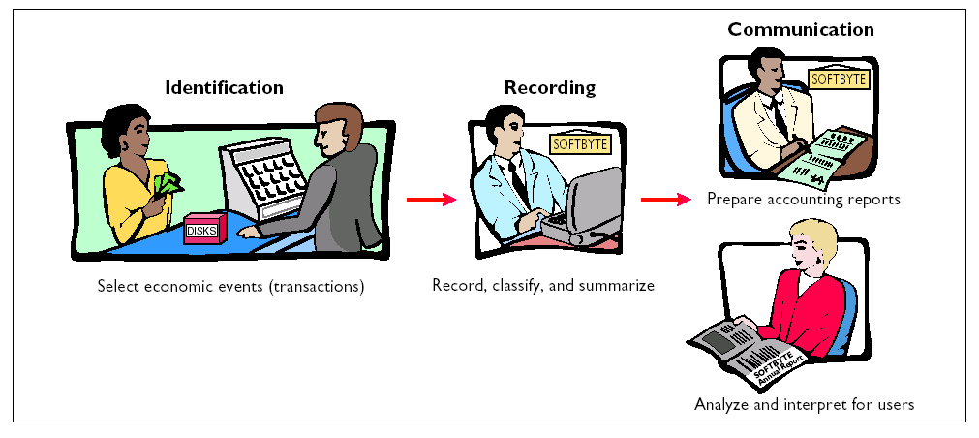
THE ACCOUNTING
PROCESS

Slide 6
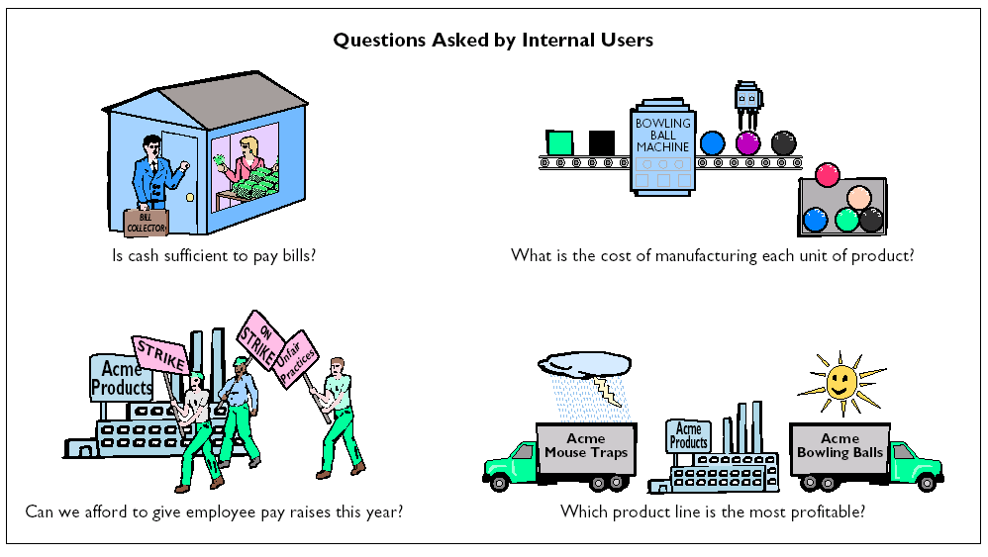
QUESTIONS ASKED BY INTERNAL USERS
STUDY OBJECTIVE 2

Slide 7
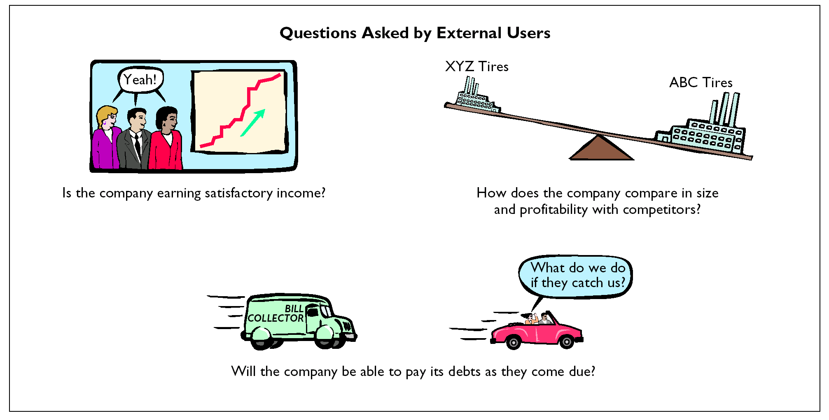
QUESTIONS ASKED BY EXTERNAL USERS

Slide 8
BOOKKEEPING DISTINGUISHED FROM ACCOUNTING
Accounting
Includes bookkeeping
Also includes much more
Bookkeeping
The recording of economic events
One part of accounting

Slide 9
THE ACCOUNTING PROFESSION
Public Accountants
  Service to the general public through the services they perform.
Private Accountants
  Individuals in companies involved in activities including cost and tax accounting, systems, and internal auditing.
Not For Profit Accountants
  Reporting and control for government units, foundations, hospitals, labor unions, colleges/universities, and charities.

Slide 10
THE BUILDING BLOCKS OF ACCOUNTING
STUDY OBJECTIVES 3, 4 & 5
Ethics
  Standards by which actions are judged as right or wrong, honest or dishonest.
Generally Accepted Accounting Principles
  Established by the F.A.S.B and the S.E.C.
Assumptions
  Monetary Unit
  Only data that can be expressed in terms of money is included in the accounting records.
  Economic Entity
  Includes any organization or unit in society.

Slide 11
BUSINESS ENTERPRISES
Proprietorship
  Owned by one person.
Partnership
  Owned by two or more persons.
Corporation
  Organized as a separate legal entity under state corporation law and having ownership divided into transferable shares of stock.

Slide 12
The accounting process is correctly sequenced as
  identification, communication, recording.
  recording, communication, identification.
  identification, recording, communication.
  communication, recording, identification.

Slide 13
The accounting process is correctly sequenced as
  identification, communication, recording.
  recording, communication, identification.
  identification, recording, communication.
  communication, recording, identification.

Slide 14
BASIC ACCOUNTING EQUATION
STUDY OBJECTIVE 6
Assets
=
Liabilities
+
Owner’s Equity

Slide 15
ASSETS AS A BUILDING BLOCK
Assets are resources owned by a business.
They are used in carrying out such activities as production, consumption and exchange.

Slide 16
LIABILITIES AS A BUILDING BLOCK
Liabilities
  are creditor claims against assets
  are existing debts and obligations

Slide 17
OWNER’S EQUITY AS A BUILDING BLOCK
Owner’s Equity = total assets minus total liabilities. (A - L = O.E.)
Owner’s Equity represents the ownership claim to total assets.
Subdivisions of Owner’s Equity:
  1 Capital or Investments by Owner (+)
  2 Drawing (-)
  3 Revenues (+)
  4 Expenses (-)

Slide 18
INVESTMENTS BY OWNERS AS A BUILDING BLOCK
Investments
  are the assets the owner puts in the business
  increase owner’s equity

Slide 19


DRAWINGS AS A BUILDING BLOCK
Drawings
  are withdrawals of cash or other assets by the owner for personal use
  decrease owner’s equity

Slide 20
REVENUES AS A BUILDING BLOCK
Revenues
  gross increases in owner’s equity from business activities entered into for the purpose of earning income
  may result from sale of merchandise, services, rental of property, or lending money
  usually result in an increase in an asset

Slide 21
EXPENSES AS A BUILDING BLOCK
  Expenses
  decreases in owner’s equity that result from operating the business
  cost of assets consumed or services used in the process of earning revenue
  examples: utility expense, rent expense, supplies expense, and tax expense

Slide 22
INCREASES AND DECREASES IN OWNER’S EQUITY
INCREASES DECREASES
Investments by Owner
Withdrawals by Owner
Owner’s Equity
Revenues
Expenses

Slide 23
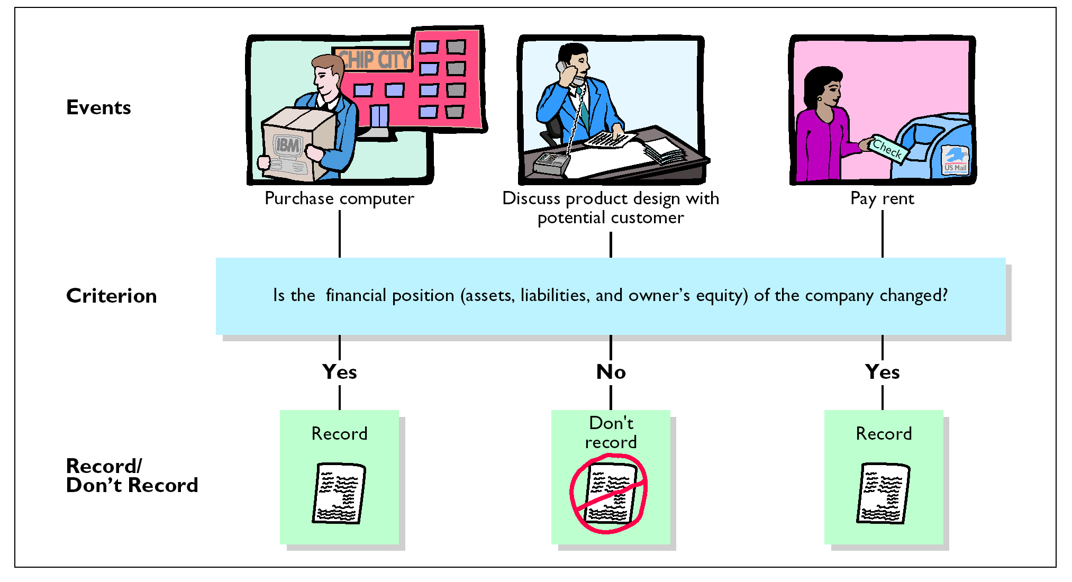
TRANSACTION IDENTIFICATION PROCESS
STUDY OBJECTIVE 6

Slide 24

TRANSACTION ANALYSIS
TRANSACTION 1
Ray Neal decides to open a computer programming service.
On September 1, he invests $15,000 cash in the business, which he names Softbyte.
Softbyte

Slide 25
TRANSACTION ANALYSIS
TRANSACTION 1 SOLUTION
Assets = Liabilities + Owner’s Equity
  Cash R. Neal, Capital
  + 15,000 Investment + 15,000
  $15,000 = $15,000
There is an increase in the asset Cash, $15,000, and an equal increase in the owner’s equity, R. Neal, Capital, $15,000.

Slide 26

TRANSACTION ANALYSIS TRANSACTION 2
Softbyte purchases computer equipment for $7,000 cash.

Slide 27
TRANSACTION ANALYSIS
TRANSACTION 2 SOLUTION
Assets = Liabilities + Owner’s Equity
Cash + Equipment = + R. Neal, Capital
Old
$15,000 = $15,000
(2) - 7,000 + 7,000______________________________
New
$ 8,000 + $7,000 = $15,000
Cash is decreased by $7,000 and the asset Equipment is increased by $7,000.

Slide 28



TRANSACTION ANALYSIS TRANSACTION 3
Softbyte purchases supplies expected to last for several months for $1,600 from Acme Supply Company.
Acme agrees to allow Softbyte to pay this bill next month, in October.
This transaction is referred to as a purchase on account or a credit purchase.
Acme Supply Company
Softbyte

Slide 29
TRANSACTION ANALYSIS
TRANSACTION 3 SOLUTION
Assets = Liabilities + Owner’s Equity
Cash + Supplies + Equip. = Accts. Pay. + R. Neal, Capital
Old $8,000 + $7,000 = $15,000
(3) _____ + $1,600 _______ + $1,600 ________
New $8,000 + $1,600 + $7,000 = + $1,600 + $15,000
$16,600 $16,600
The asset Supplies is increased by $1,600, and the liability Accounts Payable is increased by the same amount.

Slide 30



TRANSACTION ANALYSIS TRANSACTION 4
Softbyte receives $1,200 cash from customers for programming services it has provided.
This transaction represents the Softbyte’s principal revenue-producing activity.
Softbyte

Slide 31
TRANSACTION ANALYSIS
TRANSACTION 4 SOLUTION
Assets = Liabilities + Owner’s Equity
Cash + Supplies + Equip. = Accts. Pay. + R. Neal, Capital
Old $8,000 + $1,600 + $7,000 = $1,600 + $15,000
(4) + 1,200 _____ _____ _______________ + 1,200
New $9,200 + $1,600 + $7,000 = $1,600 $16,200
$17,800 $17,800
Cash is increased by $1,200 and R. Neal, Capital is increased by $1,200.

Slide 32
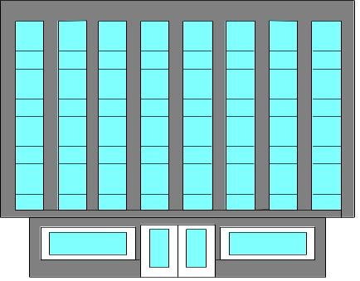

TRANSACTION ANALYSIS TRANSACTION 5
Softbyte receives a bill for $250 from the Daily News for advertising but postpones payment of the bill until a later date.
Softbyte
Bill
Daily
News

Slide 33
TRANSACTION ANALYSIS
TRANSACTION 5 SOLUTION
Assets = Liabilities + Owner’s Equity
Cash + Supplies + Equip. = Accts. Pay. + R. Neal, Capital
Old $9,200 + $1,600 + $7,000 = $1,600 + $16,200
(5) ___Advertising Expense__ + 250 _- 250
New $9,200 + $1,600 + $7,000 = $1,850 + $15,950
$17,800 $17,800
Accounts Payable is increased by $250 and R. Neal, Capital is decreased by $250.

Slide 34



TRANSACTION ANALYSIS TRANSACTION 6
Softbyte provides $3,500 of programming services for customers.
Cash of $1,500 is received from customers, and the balance of $2,000 is billed on account.
Softbyte
Bill

Slide 35
TRANSACTION ANALYSIS
TRANSACTION 6 SOLUTION
Assets = Liabilities + Owner’s Equity
Cash + Accts. Rec. + Supplies + Equip. = Accts. Pay. + R. Neal, Capital
Old
$ 9,200 + $1,600 + $7,000 = $1,850 + $15,950
(6)
+ 1,500 + 2,000 + 3,500
New
$10,700 + $2,000 + $1,600 + $7,000 = $1,850 + $19,450
$21,300 $21,300
Cash is increased by $1,500; Accounts Receivable is increased by $2,000, and R. Neal, Capital is increased by $3,500.

Slide 36
TRANSACTION ANALYSIS TRANSACTION 7
Expenses paid in cash for September are store rent, $600; employees’ salaries, $900; and utilities, $200.
$600
$900
Softbyte
$200

Slide 37
TRANSACTION ANALYSIS
TRANSACTION 7 SOLUTION
Assets = Liabilities + Owner’s Equity
Cash + Accts. Rec. + Supplies + Equip. = Accts. Pay. + R. Neal, Capital
Old
$10,700 + $2,000 + $1,600 + $7,000 = $1,850 + $19,450
(7)
- 1,700 Rent Expense - 600
Salaries Expense - 900
Utilities Expense - 200
New
$ 9,000 + $2,000 + $1,600 + $7,000 = $1,850 + $17,750
$19,600 $19,600
Cash is decreased by $1,700 and R. Neal, Capital is decreased by the same amount.

Slide 38
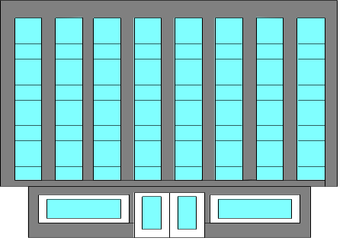

TRANSACTION ANALYSIS TRANSACTION 8
Softbyte pays its $250 Daily News advertising bill in cash.
Softbyte
Daily
News

Slide 39
TRANSACTION ANALYSIS
TRANSACTION 8 SOLUTION
Assets = Liabilities + Owner’s Equity
Cash + Accts. Rec. + Supplies + Equip. = Accts. Pay. + R. Neal, Capital
Old
$9,000 + $2,000 + $1,600 + $7,000 = $1,850 + $17,750
(8)- 250 - 250 .
New
$8,750 + $2,000 + $1,600 + $7,000 = $1,600 + $17,750
$19,350 $19,350
Both Cash and Accounts Payable are decreased by $250. Since the expense was previously recorded, it is not recorded now.

Slide 40


TRANSACTION ANALYSIS
TRANSACTION 9
The sum of $600 in cash is received from customers who have previously been billed for services (in Transaction 6).
Softbyte

Slide 41
TRANSACTION ANALYSIS
TRANSACTION 9 SOLUTION
Assets = Liabilities + Owner’s Equity
Cash + Accts. Rec. + Supplies + Equip. = Accts. Pay. + R. Neal, Capital
Old
$8,750 + $2,000 + $1,600 + $7,000 = $1,600 + $17,750
(9) + 600 - 600 .
New
$9,350 + $1,400 + $1,600 + $7,000 = $1,600 + $17,750
$19,350 $19,350
Cash is increased by $600 and Accounts Receivable is decreased by the same amount. R. Neal, Capital is not increased because the revenue was already recorded.

Slide 42

TRANSACTION ANALYSIS TRANSACTION 10
Ray Neal withdraws $1,300 in cash from the business for his personal use.
$1,300
Softbyte

Slide 43
TRANSACTION ANALYSIS
TRANSACTION 10 SOLUTION
Assets = Liabilities + Owner’s Equity
Cash + Accts. Rec. + Supplies + Equip = Accts. Pay. + R. Neal, Capital
Old
$9,350 + $1,400 + $1,600 + $7,000 = $1,600 + $17,750
(10)
- 1,300 Drawing - 1,300
New
$8,050 + $1,400 + $1,600 + $7,000 = $1,600 + $16,450
$18,050 $18,050
Cash is decreased by $1,300 and R. Neal, Capital is decreased by the same amount. This is not an expense, but rather a withdrawal of owner’s equity.

Slide 44
FINANCIAL STATEMENTS
STUDY OBJECTIVE 8
Four financial statements are prepared from the summarized accounting data:
Income Statement
revenues and expenses and resulting net income or net loss for a specific period of time
Owner’s Equity Statement
changes in owner’s equity for a specific period of time
Balance Sheet
assets, liabilities, and owner’s equity at a specific date
Statement of Cash Flows
cash inflows (receipts) and outflows (payments) for a specific period of time

Slide 45
FINANCIAL STATEMENTS AND THEIR INTERRELATIONSHIPS
SOFTBYTE, INC.
Income Statement
For the Month Ended September 30, 2005
Revenues
Service revenue
$ 4,700
Expenses
Salaries expense
$ 900
Rent expense
600
Advertising expense
250
Utilities expense
200
Total expenses
1,950
Net income
$ 2,750
Net income of $2,750 shown on the income statement is added to the beginning balance of owner’s capital in the owner’s equity statement.

Slide 46
FINANCIAL STATEMENTS AND THEIR INTERRELATIONSHIPS
SOFTBYTE, INC.
Owner’s Equity Statement
For the Month Ended September 30, 2005
Retained earnings, September 1, 2005
$ -0-
Add: Investments
$ 15,000
Net income
2,750
17,750
17,750
Less: Drawings
1,300
Retained earnings, September 30, 2005
$16,450
Net income of $2,750 carried forward from the income statement to the owner’s equity statement. The owner’s capital of $16,450 at the end of the reporting period is shown as the final total of the owner’s equity column of the Summary of Transactions (Illustration 1-8).

Slide 47
FINANCIAL STATEMENTS AND THEIR INTERRELATIONSHIPS
SOFTBYTE, INC.
Balance Sheet
September 30, 2005
Assets
Cash
$ 8,050
Accounts receivable
1,400
Supplies
1,600
Equipment
7,000
Total assets
$ 18,050
Liabilities and Owner’s Equity
Liabilities
Accounts payable
$ 1,600
Owner’s equity
R. Neal, capital
16,450
Total liabilities and owner’s equity
$ 18,050
Owner’s capital of $16,450 at the end of the reporting period shown in the owner’s equity statement is shown on the balance sheet.

Slide 48
FINANCIAL STATEMENTS AND THEIR INTERRELATIONSHIPS
SOFTBYTE, INC.
Balance Sheet
September 30, 2005
Assets
Cash
$ 8,050
Accounts receivable
1,400
Supplies
1,600
Equipment
7,000
Total assets
$ 18,050
Liabilities and Owner’s Equity
Liabilities
Accounts payable
$ 1,600
Owner’s equity
R. Neal, capital
16,450
Total liabilities and owner’s equity
$ 18,050
Cash of $8,050 on the balance sheet is reported on the statement of cash flows.
Notes:
Format Help

Slide 49
FINANCIAL STATEMENTS AND THEIR INTERRELATIONSHIPS
SOFTBYTE, INC.
Statement of Cash Flows
For the Month Ended September 30, 2005
Cash flows from operating activities
Cash receipts from revenues
$ 3,300
Cash payments for expenses
(1,950)
Net cash provided by operating activities
1,350
Cash flows from investing activities
Purchase of equipment
(7,000)
Cash flows from financing activities
Sale of common stock
$ 15,000
Payment of cash dividends
(1,300)
Net cash provided by financing activities
13,700
Net increase in cash
8,050
Cash at the beginning of the period
–
0
–
Cash at the end of the period
$ 8,050
Cash of $8,050 on the balance sheet and statement of cash flows is shown as the final total of the cash column of the Summary of Transactions (Illustration 1-8).
Notes:
Fix ME- Help!

Slide 50
Which of the following is not an advantage of the corporate form of business organization?
  Limited liability of stockholders
  Transferability of ownership
  Unlimited personal liability for stockholders
  Unlimited life

Slide 51
Which of the following is not an advantage of the corporate form of business organization?
  Limited liability of stockholders
  Transferability of ownership
  Unlimited personal liability for stockholders
  Unlimited life

Slide 52

COPYRIGHT
Copyright © 2005 John Wiley & Sons, Inc. All rights reserved. Reproduction or translation of this work beyond that permitted in Section 117 of the 1976 United States Copyright Act without the express written consent of the copyright owner is unlawful. Request for further information should be addressed to the Permissions Department, John Wiley & Sons, Inc. The purchaser may make back-up copies for his/her own use only and not for distribution or resale. The Publisher assumes no responsibility for errors, omissions, or damages, caused by the use of these programs or from the use of the information contained herein.

